Slide 1

Notes:
Good afternoon. Thanks for attending this virtual session. Unfortunately, a virtual haircut is not available with the technology I have.

Slide 2

Two Full Capacity Generators –
Why is the Calculated Emergency Power System PFD so High?
Arthur M. (Art) Dowell, III, PE
Process Improvement Institute, Inc.
©2020 Process Improvement Institute, Inc., all rights reserved
Notes:
Good afternoon. Thanks for attending this virtual session. Unfortunately, a virtual haircut is not available with the technology I have.

Slide 3
Content
Introduction
Fault Tree Analysis
Recommendations to Reduce PFD
Maintaining Integrity
Conclusion

Slide 4
Introduction: Emergency Power Needed to Protect During Power Loss
For some LOPA scenarios with power outage leading to
  Human Harm
  Equipment Damage
  Environmental Damage
Protection Layers may include
  Pumps, compressors, and blowers operating during the power outage
  Emergency lighting for emergency responders during the power outage
Need EPS to support IPLs
IE
Consequences
Candidate IPLs

Slide 5
EPS Schematic

Slide 6
Tests
Generators run weekly
Quarterly inspection and maintenance
Full functional test every 4 years

Slide 7
What do you think?
Are the two generator systems completely independent?
NO!
Common bulk fuel system
Common power to both fuel transfer pumps – same UPS circuit.
Common causes for genset parts
  From same manufacturers
  Maintained by same technicians
Safety circuits in Relay Cabinet can trip both gensets

Slide 8
Lack of Genset Independence
Unable to use a generic PFD value from industry data sources
Necessary to do fault tree analysis (FTA)

Slide 9
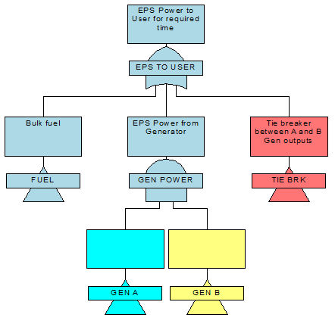
FTA Top Event
OR
AND

Slide 10
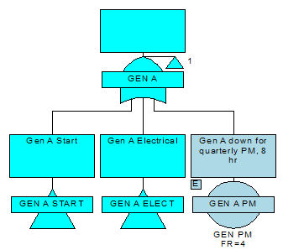
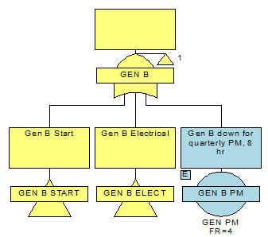
Generator
Sub-Trees
OR
OR

Slide 11
FTA Results
Test Interval | 4 years (current) | 1 year (proposed)
PFD (probability of failure on demand) | 3x10-1 (0.3) | 1x10-1 (0.1)

Slide 12
Surely a system with redundancy, weekly test runs, quarterly PM, and annual proof tests should give a lower PFD. Why not?
The culprits are
  Common cause,
  Weekly test run coverage,
  Quarterly PM coverage
  4-year full functional proof test interval (current)
  Large number of relays in the control circuits
  Human error in adjusting setpoints for electrical safety (voltage, current)
  Spurious trips from electrical safety devices

Slide 13
Common Cause
One failure disables two or more seemingly redundant systems, e.g.,
  Power from Gen A
  Power from Gen B
Examples:
  Genset parts from same manufacturers
  Maintained by same technicians (human error)

Slide 14
FTA Top Event
Common Cause
OR
AND

Slide 15
Common
Cause
Failures
CCF
Located farther down in the tree
OR
OR
CCF1
CCF2
CCF1
CCF2

Slide 16
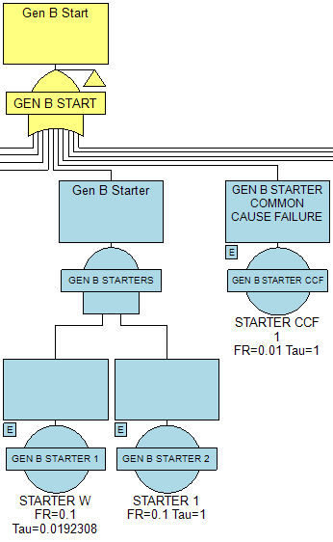
Example of Common Cause for Redundant Equipment
OR
(
(
)
)
AND

Slide 17
Coverage for weekly, quarterly, and 4-year tests
Coverage is the fraction of failures that a given test can detect.
Weekly test
  Generator diesel engine starts – know that 1oo2 battery and 1oo2 starters are working. Don’t know the status of each battery or each starter.
Quarterly PM – oil change, some inspections
4-year full functional proof test interval (current)
  Many hidden failures cannot be detected until full functional test

Slide 18
Large number of relays in the control circuits
Opportunities for loose wires to cause spurious trips

Slide 19
Human error in adjusting setpoints for electrical safety (voltage, current, timers)
Old equipment was cumbersome to adjust
Required meter hook-up and turning a screw
Error-prone

Slide 20
Spurious trips from electrical safety devices
“Safe” failures from protective equipment
  Electrical fault
  Bus failure
  Voltage failure
  Generator Trip
  Engine failure
Can trip one or both gensets.

Slide 21
Recommendations to Reduce PFD
Reduce common cause failures where possible
Improve weekly and monthly test coverage
Increase the frequency of full functional proof tests
Replace obsolete relay cabinet with a safety-rated PLC
Minimize the effect of “safe” failures of protective equipment
Reduce human errors by
  Replace error-prone electromechanical timers with safety-rated PLC
  Stagger maintenance and calibration between Gen A and Gen B (Different crews or different days)

Slide 22
Maintaining EPS Integrity
Use a management system to maintain the EPS system integrity throughout its life cycle.
Ensure the organization is committed to process safety, including process safety culture, compliance with standards, process safety competency, and workforce involvement:
  Who does what when,
  training required,
  competency,
  audit,
  investigate deviations,
  MOC

Slide 23
Conclusion
Facility knew that the performance of the backup emergency power supply from the two generators was less than desirable.
Facility was somewhat surprised that the fault tree analysis showed a relatively large number of device failures that could prevent both generators from operating correctly.
Fault tree analysis provided the basis for recommendations to improve the PFD of the EPS.
Need management system to ensure that the integrity of the EPS is managed throughout its lifecycle

Slide 24

Questions?
Art Dowell
Process Improvement Institute
adowell@piii.com
This Photo by Unknown Author is licensed under CC BY-SA
Notes:
Thanks for listening. Here is my contact information if you have questions that we don’t get answered in the next few minutes.

